Slide 1

Year 4 Parent Meeting
Multiplication Check (MTC) 2026

Slide 2
Session Aims:
- The purpose of the MTC
- When it will take place (June 2026)
- How the MTC is administered
- How you can support your child at home, in preparation for the check.

Slide 3
What is the purpose of the MTC check?
Known as the Multiplication Tables Check (MTC), it’s purpose is to determine whether year 4 pupils can fluently recall their multiplication tables.
‘By the end of year 4, pupils should have memorised their multiplication tables up to and including the 12 multiplication table and show precision and fluency in their work’.
They are designed to help schools identify which children require more support to learn their times tables, so they can access the demands of the Y5 and Y6 maths curriculum with success.

Slide 4
Important information about the MTC
There is no ‘pass’ rate or threshold which means that, unlike the Phonics Screening Check, children will not be expected to re-sit the check.
The Department for Education (DfE) will create a report about the overall results across all schools in England, not individual schools.

Slide 5
When the check will take place
There will be a 2 week window from Monday 1 June 2026 for schools to administer the check.
There is no set day to administer the check and children are not expected to take the check at the same time.
All eligible Year 4 children in England will be required to take the check.

Slide 6
How the MTC is administered
The check is fully digital. It will be completed on a tablet.
Answers will be entered using an on-screen number pad.
Usually, the check will take less than 5 minutes for each child.
Notes:
Practice on a tablet too, to get used to the format.

Slide 7
How the MTC is administered
The children will have 6 seconds from the time the question appears to input their answer.
There will be a total of 25 questions with a 3 second pause in-between questions.
There will be 3 practice questions before the check begins.

Slide 8
Specific arrangements
Some children will be eligible for specific arrangements:
Colour contrast;
Font size adjustment;
‘Next’ button (alternative to 3-second pause);
Removing on-screen number pad;
An adult to input answers;
Audio version;
Audible time alert.

Slide 9
The questions
Each child will be randomly assigned a set of questions
There will only be multiplication questions in the check, not division facts.
Children will not see their individual results when they complete the check.

Slide 10
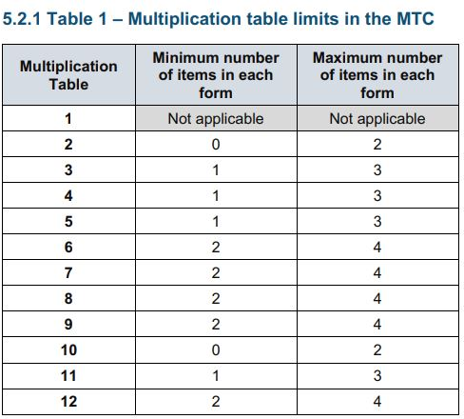
The questions
The table (published by the Standards and Testing Agency - STA) shows the minimum/ maximum number of questions from each times table that will be asked.
The 6, 7, 8, 9 and 12 times tables are more likely to be asked.
Reversal of questions (e.g. 8 x 6 and 6 x 8) will not be asked in the same check.
Notes:
Some questions will be repeated across different checks, but no more than 30% of questions will be repeated in any two checks. This means that if the check gets interrupted and children need to re-start it, they will only have a minimal advantage.
During the check pupils may be able to restart if certain conditions are met (e.g. a fire alarm).
The results will be sent to the schools when all the checks have been completed but it is then up to the school if they report the results or not.
There won’t be questions from the 1 times tables (although they might be included in the 3 practice questions).
There will be a maximum of 7 questions from the 2, 5 and 10 times tables.
There is a focus on the 6, 7, 8, 9 and 12 times tables as they are the ‘most difficult’ multiplication tables.

Slide 11
Ways to support times table knowledge
Count and look for patterns.
Understand that multiplication is repeated addition.
Remember that multiplication is commutative.
Remember that multiplication is the inverse of division.
Recall and utilise fact families.
Use different representations to represent multiplication, such as:
Concrete manipulatives such as multilink cubes or counters.
Create pictorial representations such as arrays.

Slide 12

Counting and looking for patterns
Example: Counting in 2s
2, 4, 6, 8, 10…
Ensure children have a strong understanding of counting in groups first.
When children are secure with counting, they can then look for patterns.
Notes:
Counting will start before beginning to develop understanding and reasoning but will continue long after, until all times tables can be counted through sequentially at speed.
Counting using manipulatives should start with physical objects (shoes, socks, hands etc) before moving on to counters etc
Whenever starting children counting in a new amount, such as counting in 8s, children should be given the opportunity to see visually what that looks like to reinforce 4 x 8 looks quite big compared to 4 x 6.
Patterns could be 4 x 8 is the same as 4 x 4 doubled.

Slide 13
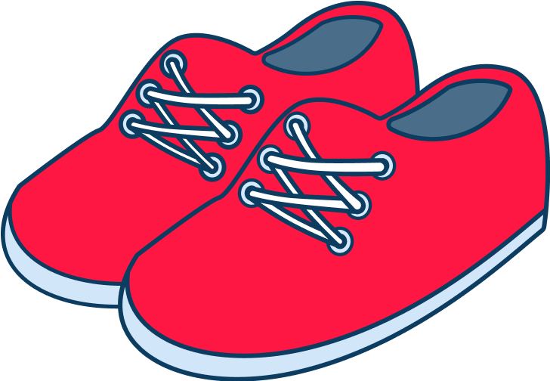

Repeated addition
Knowing that 2 x 4 is the same as 2 + 2 + 2 + 2
2 + 2 + 2 + 2 = ?
2 x 4 = ?
Notes:
Children need experience of using concrete manipulatives such as counters or multilink cubes and pictorial representations of objects, forming arrays.

Slide 14


Multiplication is commutative
3 x 2 is the same as 2 x 3
Children need to understand that multiplication can be completed in any order to produce the same answer. Sometimes this link needs to be made explicit.
3 lots of 2 = 6
2 lots of 3 = 6
Notes:
Children build on their existing understanding using arrays, turning the arrays around to show that you now have 2 groups of 3 and they will still total 6. This can then be linked to recalling multiplication facts, e.g. if they know their 2 times table as facts but not their 3 times table, they can use 2 x 3 to work out 3 x 2.

Slide 15

Multiplication is the inverse of division
20 ÷ 5 = 4 can be worked out because 5 x 4 = 20
Using pictorial representations (such as arrays) is useful here for children to see the link between multiplication and division.
Notes:
Even though division is not tested in the MTC, it is important that pupils have a strong understanding of the connection between multiplication and division.
Again, the use of arrays is key. Children need experience of pulling arrays apart into groups or sharing. After basic experience has been gained, the children should start to ‘see’ an array structure as 5 groups of 4 equal 20 and 20 can be split into 5 groups of 4.

Slide 16
Fact families
4 x 5 = 20, 20 ÷ 5 = 4
5 x 4 = 20, 20 ÷ 4 = 5
Due to their commutative understanding, children should also be able to see whole number families. For many children this will need to be pointed out and discussed.
20
4
5
Notes:
From here it is only a short jump to understanding that any missing number can be worked out through knowledge of fact families, e.g. 4 x [ ] = 20 or [ ] ÷ 4 = 5. There are other methods children can use to work out missing numbers but our goal is to increase working memory in order to increase instant recall from long term memory. Being able to bounce around a fact family will achieve that.

Slide 17
Using known facts
4 x 6 = ?
I know 4 x 5 = 20
Therefore, 20 + 4 = 24
By using known facts from ‘easier’ times tables, children should be able to find answers with increasing speed.
+

Slide 18
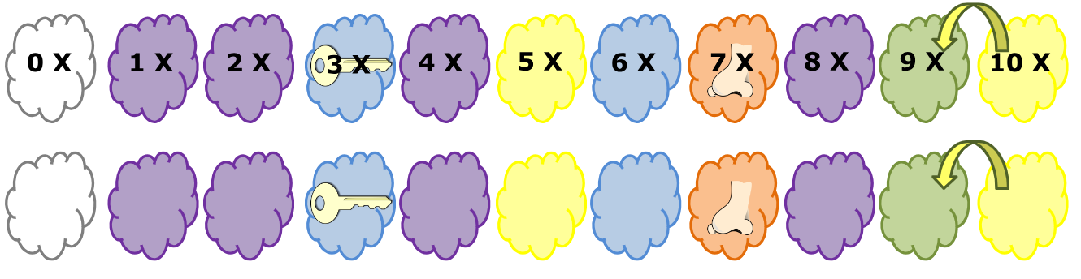
Using relationships
0
6
12
18
24
30
36
42
48
54
60

Slide 19
How best to prepare your child for the check
Remind them that the check should last no more than 5 minutes.
If you want to go over times tables, make them fun.
If you have any concerns, talk to your child’s teacher.
If your child has any concerns, encourage them to talk to a trusted adult (for example, yourself, their teacher).

Slide 20
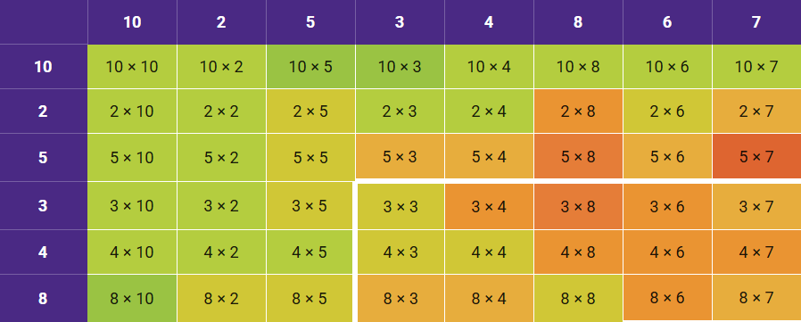
Times Table Rock Stars!
Your child has been sent home with their TTRS ‘Heat Map’ this week. The colours help you see how your child is responding to each fact.
In school, we will focus on teaching them new facts and working on red facts. At home, focus on the green and orange facts to support what is already known.
Notes:
Dark green = answering in under 1 second
Dark red = answering in over 10 seconds.
Orange and red = facts that are more challenging

Slide 21
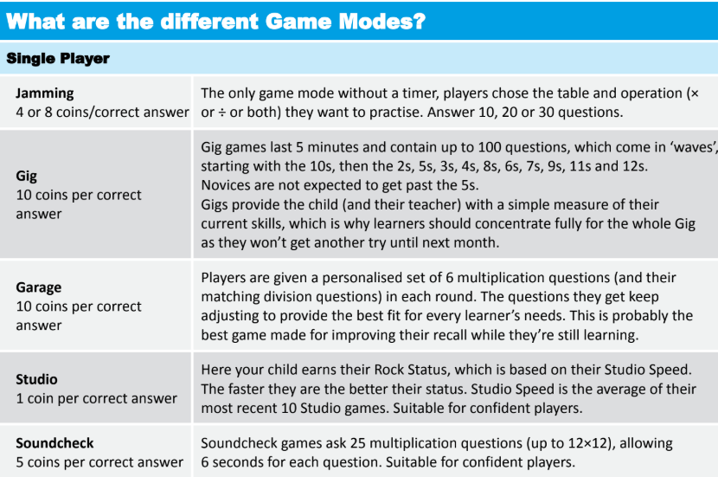
Play daily!
MTC Simulator
Notes:
Make sure they play daily in Garage mode on Times Tables Rock Stars - The Garage game mode is very clever and will adjust the questions your child is asked, ensuring they are always working on the facts they need to improve. Also, give them a times tables square to use whilst they play. This way they can double-check facts they are not sure about

Slide 22
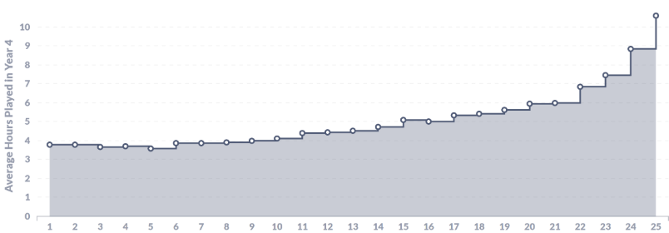
How much do they need to play to get 25/25
Drawing on the data in the graph above, those who played more than an average of 13 minutes per school week in year 4, scored 22/25 or more.
To get full marks, seems to take an average of 10 hours 36 minutes over year 4, which equates to⭐21 minutes⭐ per school week.

Slide 23
How best to prepare your child for the check
Sing times tables songs. There are hundreds available! Put them on in the car, bathtime or any ‘free’ time where you have a few spare minutes.
Chanting the old-fashioned way- rehearse the tables forwards and backwards, gradually increasing in speed.
Write out the tables – This can be in the form of a simple list or you could also be a bit more fun. Being creative will make writing and learning the tables more enjoyable.
  Write the facts as the petals of a flower;
  Get them to test you on the facts and get them wrong on purpose and see if they correct you!
  Treasure Hunt: Hide the facts around the house and give them the answers. Can they find them in record time?
  Take a pot of water and a paintbrush outside to ‘paint’ the facts on a wall.
  Use chalks to write the facts outside in giant numbers.
Times tables are important, but it should be an enjoyable experience learning them! Give lots of praise for every fact recalled successfully!

Slide 24
Times tables songs:
https://www.youtube.com/watch?v=e7rYbk9PNuM 6 times table (Shake It Off)
https://www.youtube.com/watch?v=9os1VUUp5io 6 times table (Teachers cover) (Dr DeMaio)
https://www.youtube.com/watch?v=8QU_E0u-tP4 4 times table (I’m Still Standing)
https://www.youtube.com/watch?v=UJY1_fzzM6Y 4 times tables (break dancing rap)
https://www.youtube.com/watch?v=z_BJjR9rdwA 8 times table (Rolling In the Deep)
https://www.youtube.com/watch?v=TdqAA9Ky2DY 8 times table (Skip counting at faster rate - guitar)
https://www.youtube.com/watch?v=5XT3vxohtBg 7 times table (Happy)

Slide 25
Times tables games:
https://mathsframe.co.uk/en/resources/resource/318/Tommys-Trek-Times-Tables Mario like game to encourage to use at home
https://www.mathschase.com/all-games/ Rapid recall fun! Mixed or single TT to 12 with chaser if mixed manually. Also adding/subtracting/dividing by different numbers. Skip counting in TT sequences. Place Value up to 1000 words and digits.
https://www.topmarks.co.uk/maths-games/hit-the-button all timestables. Hit the answer or hit the question tabs for challenge after mastering rapid recall of all to 12 x 12
https://www.mathplayground.com/brain_workouts/brain_workout_02_multiplication.html Make a line of 3 to multiply to reach product target challenge.
http://www.mathszone.net/mw/number/100sq/index.html 100 square to show patterns of each time table for skip counting.
https://www.timestables.co.uk/speed-test/ 100 second speed text can be programmed.

Slide 26
Session Aims:
- The purpose of the MTC
- When it will take place (June 2026)
- How the MTC is administered
- How you can support your child at home, in preparation for the check.
Handouts!
Times Table Counting Stick
Multipliction Square
TTRS parent information and MTC information letter
Thank you for listening ☺

Slide 27
