Slide 1
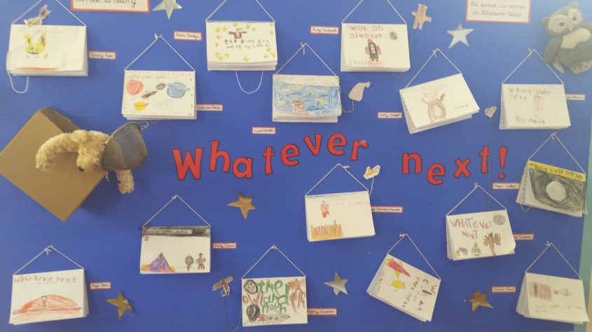
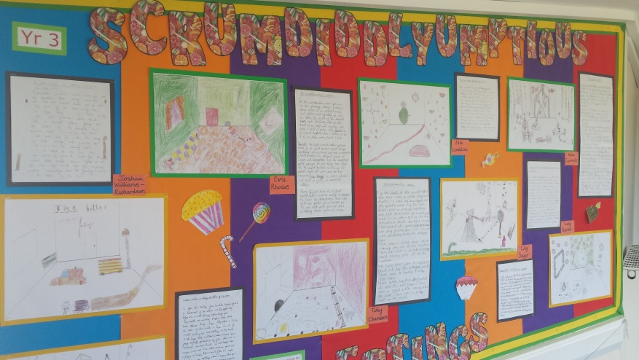
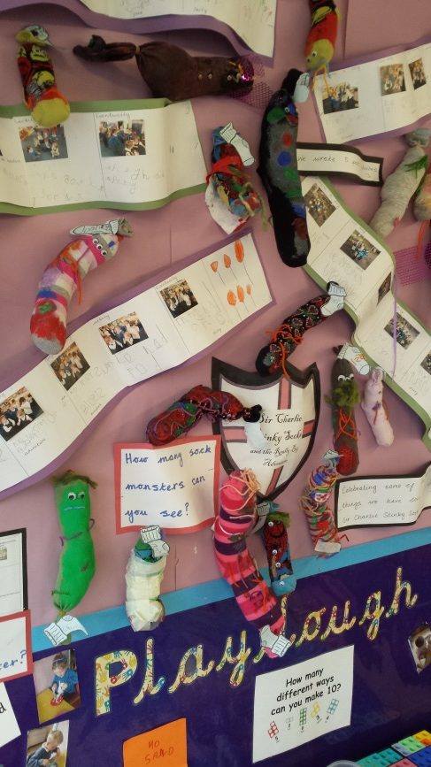
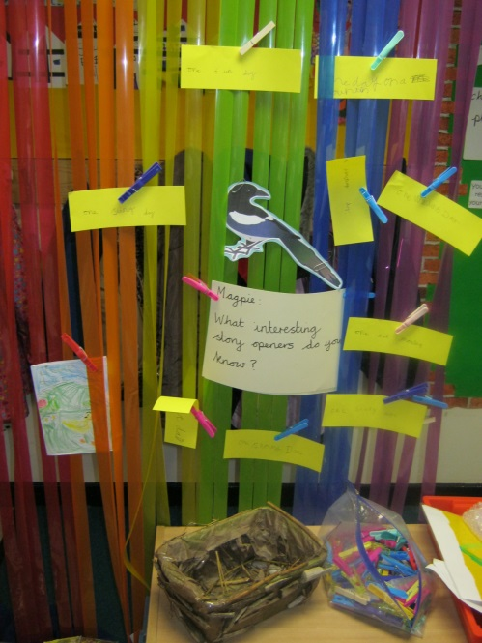
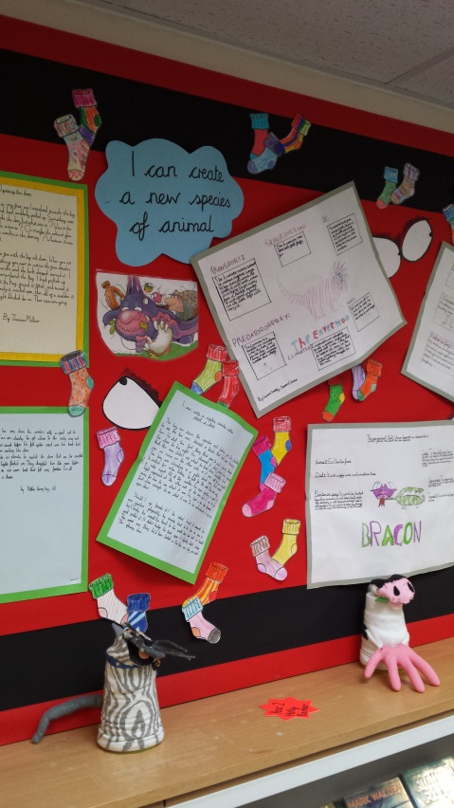
The Teaching of Writing at Billingshurst Primary

Slide 2
Aims
To share key changes in the teaching of writing at BPS
To introduce the key concepts of Talk for Writing
To share strategies that are used in school and how they can be adapted to be used at home

Slide 3
Talk for Writing
Developed in 2007-8 by Pie Corbett
Came as a response to writing falling behind reading achievement, especially for boys
Based on the principles of how children learn.
Enables children to imitate the language they need for a particular piece of writing orally before reading and analysing it and then writing their own version

Slide 4
Our wish….
For every child to love writing by engaging them with meaningful tasks which give writing a purpose.

Slide 5
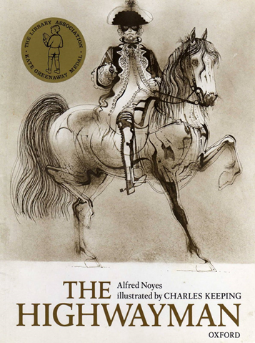
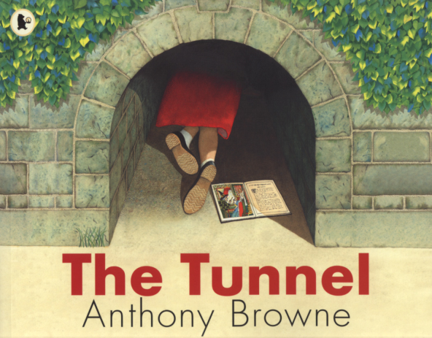
The Power of Talk
Hearing and telling stories is the most powerful way of acquiring language

Slide 6
Word and Language Games
Children need to generate ideas before we are able to teach them to write.

Slide 7
IMITATION
INNOVATION
INVENTION

